Slide 1
LEISURE TIME AND ENTERTAINMENT
Anna Švamberková

Slide 2
Definitions
Free time is time spent away from business, work, job hunting, domestic chores, and education, as well as necessary activities such as eating and sleeping.
Entertainment is a form of activity that holds the attention and interest of an audience, or gives pleasure and delight. It can be an idea or a task, but is more likely to be one of the activities or events that have developed over thousands of years specifically for the purpose of keeping an audience's attention.

Slide 3
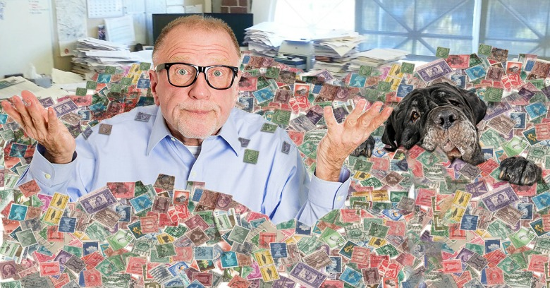
Types
Serious leisure

Slide 4
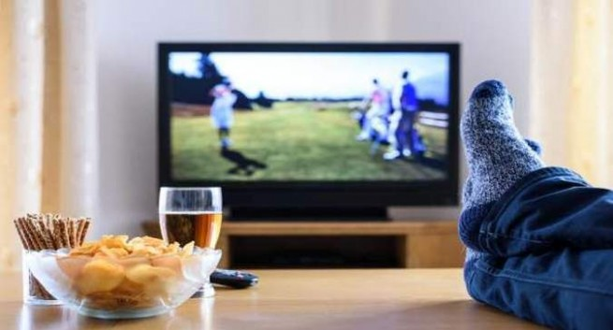
Types
Casual leisure

Slide 5
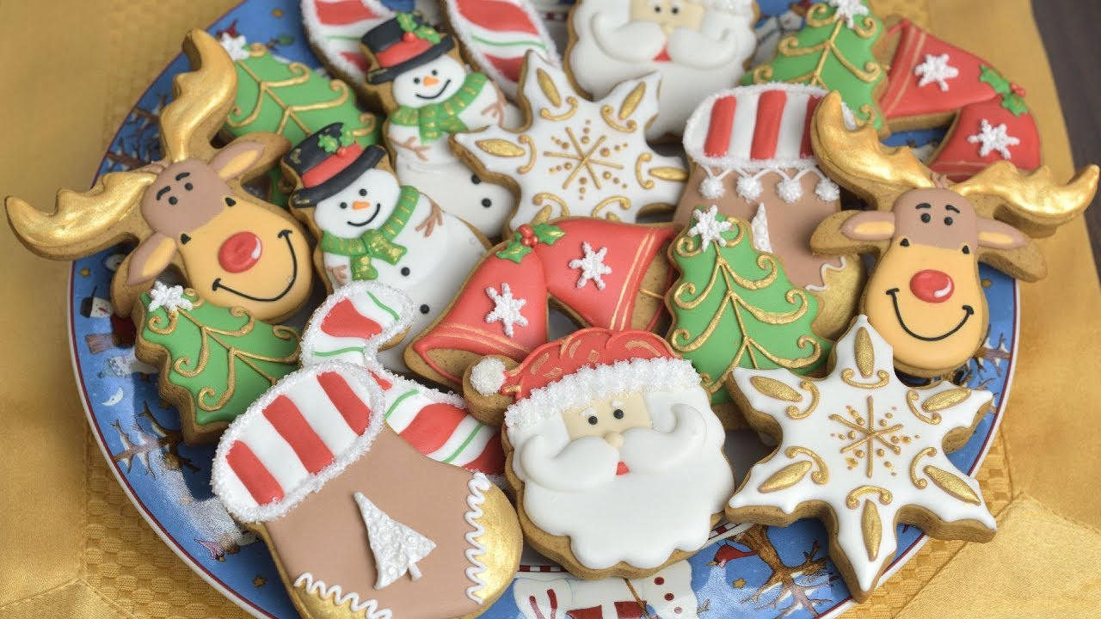
Types
Project-based leisure

Slide 6
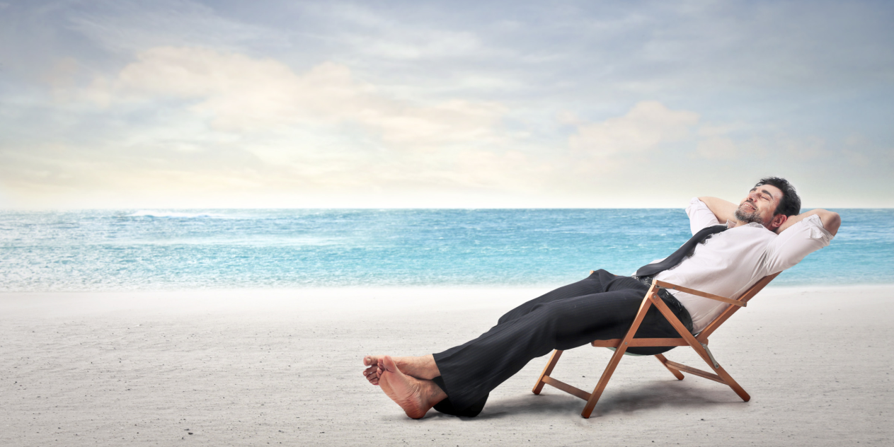
FREE TIME
Time to relax
Time for hobbies
Family time
Time with friends

Slide 7
Sports

Slide 8
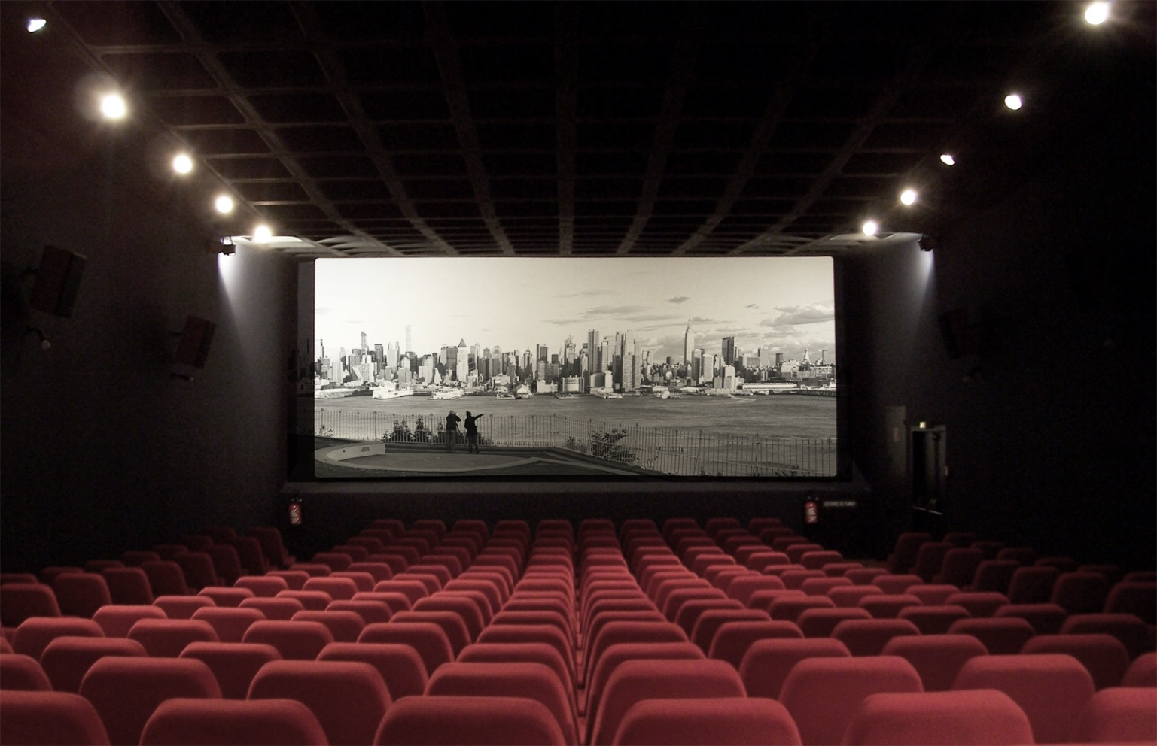
Cinema and Theatre

Slide 9
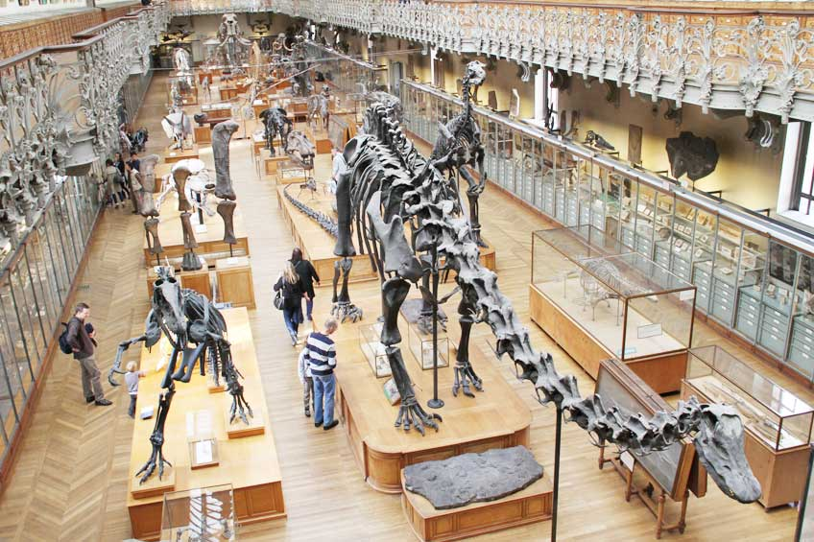
Museum

Slide 10
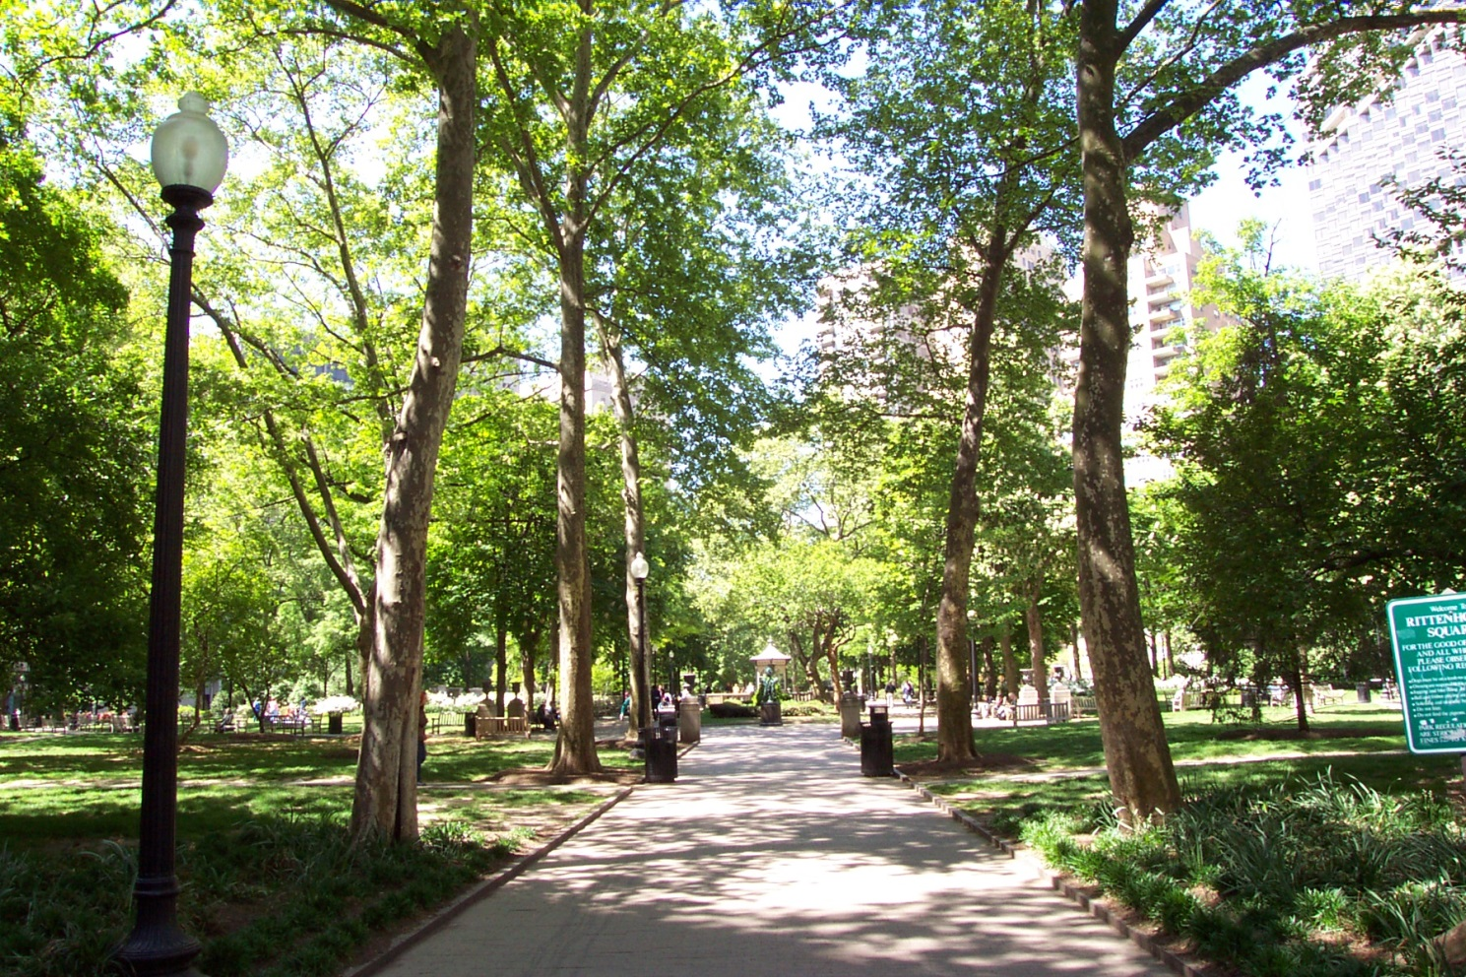
Nature

Slide 11
Music

Slide 12
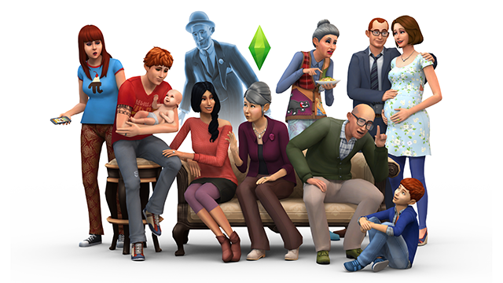
Games

Slide 13
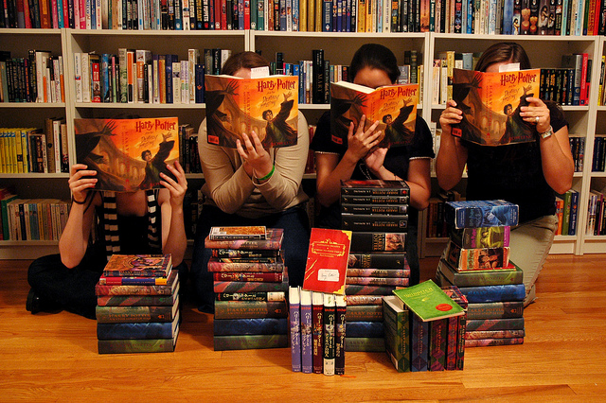
Reading

Slide 14
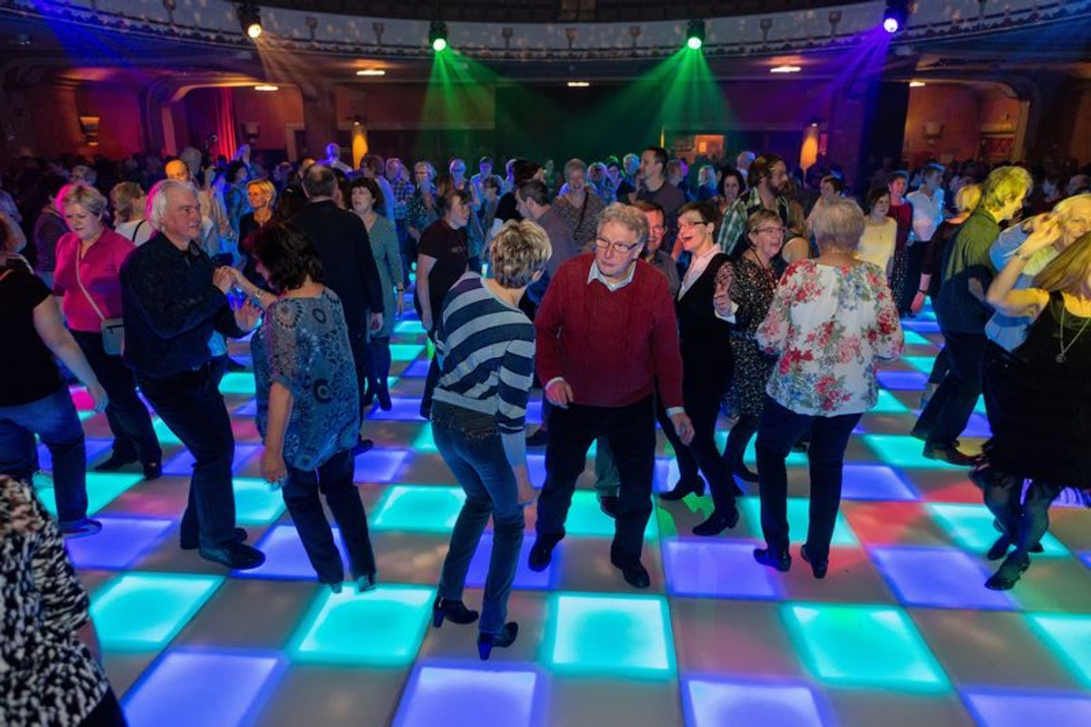
Dance

Slide 15
Shopping

