Slide 1
Food and healthy lifestyle
Dominika Průšová
Oktáva 2018/2019

Slide 2
What is a healthy lifestyle?
A healthy lifestyle is one which helps to keep and improve people's health and well-being
The ways to being healthy include healthy eating, physical activities, weight management, and stress management

Slide 3
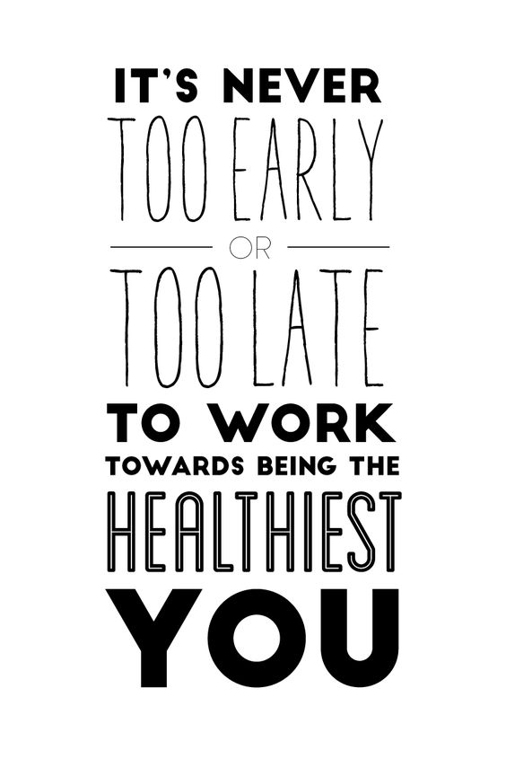
How to be healthy?
Proper diet
Physical exercise
Enough sleep
Positive thinking
No addictions

Slide 4
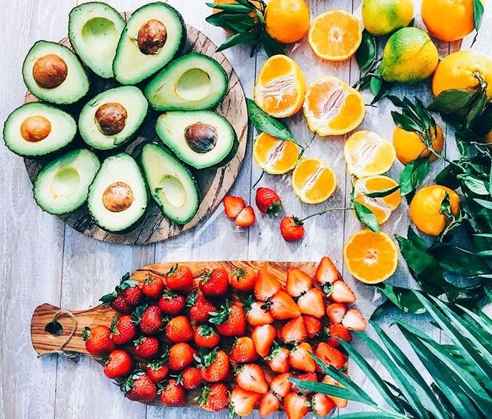
Healthy diet
A healthy diet is a diet that helps to maintain or improve overall health. A healthy diet provides the body with essential nutrition: fluid, macronutrients, micronutrients, and adequate calories

Slide 5
How to eat healthily?
Lots of fruit and vegetable
Eat more fish
Cut down on saturated fat and sugar
Eat less salt
Drink a lot of water
Eat more protein
Make it a lifestyle, not a diet

Slide 6
Calories and macronutrients
Daily calorie recommendation: 2000 kcal
Macronutrients:
Carbohydrates - 60 percent of calories from carbs
Protein - 10 to 35 percent of calories from protein
Fat - 20 percent and 35 percent of daily calories should come from fat

Slide 7
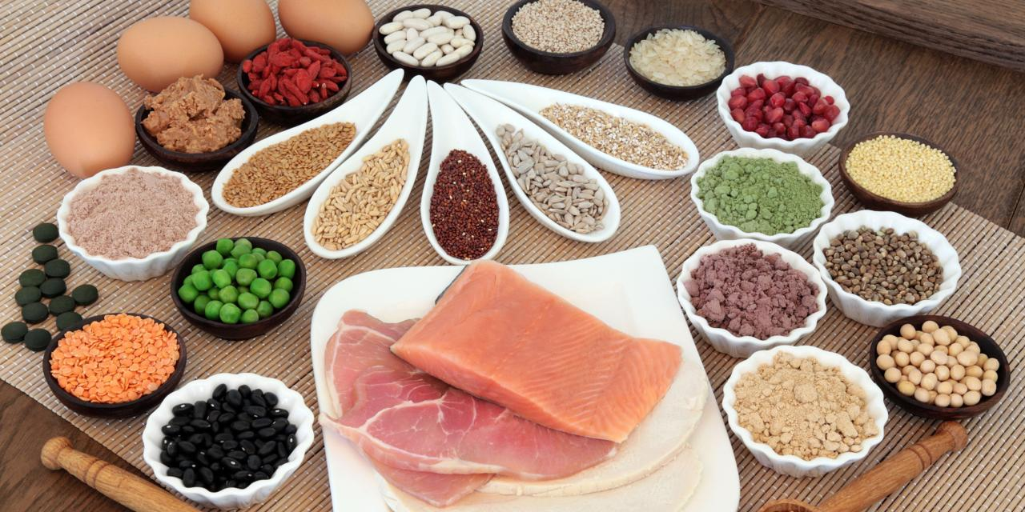
Protein
Meat
Eggs
Dairy products
Beans
Nuts
Soy and tofu products

Slide 8
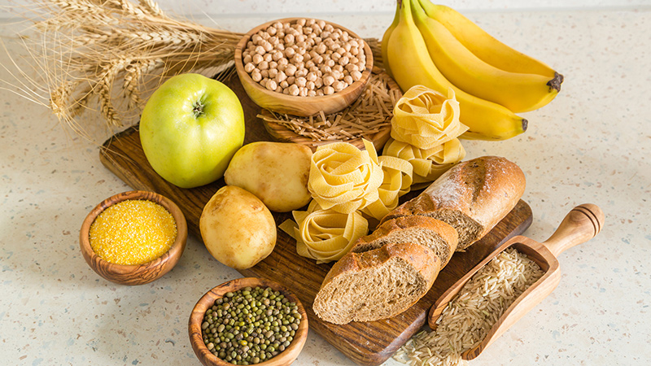
Carbohydrate
Bread
Rice
Pasta
Oats
Starchy vegetables
Fruit

Slide 9
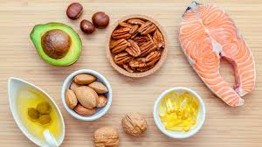
Fat
Avocado
Cheese
Eggs
Nuts
Fish
Olive oil
Seeds

Slide 10
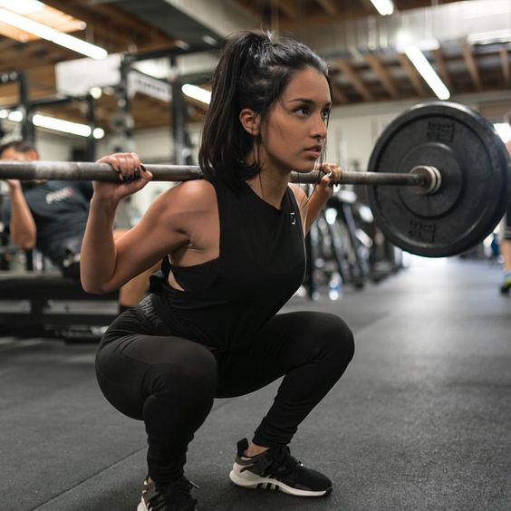
Exercise
At least 3 times a week
Many health benefits
Aerobic exercise, Anaerobic exercies, Flexibility exercises

Slide 11
Benefits of exercising
Increasing growth and development
Preventing aging
Strethening muscles and the cardiovascular system
Weight loss/weight maintence/weight gain
Reduces stress

Slide 12
Mental health (how to be mentally healthy?)
Talk about your feelings
Be active
Eat well
Ask for help
Take a break
Be grateful
Do what you enjoy
Go out

Slide 13
Vocabulary
essential nutrition – základní/nezbytná výživa
adequate calories - dostatečné množství kalorií
saturated fat – nasycený tuk
dairy products – mléčné výrobky
enhance – zlepšit
limber - ohebný

Slide 14
Zdroje
https://simple.wikipedia.org/wiki/Healthy_lifestyle
https://www.gaiam.com/blogs/discover/15-easy-ways-to-be-healthier
https://www.nhs.uk/live-well/eat-well/eight-tips-for-healthy-eating/
https://healthyeating.sfgate.com/daily-calories-macronutrients-5927.html
https://healthy-kids.com.au/kids/high-school-2/macronutrients/
https://en.wikipedia.org/wiki/Exercise
http://www.mentalhealthamerica.net/31-tips-boost-your-mental-health

