Slide 1
New Zealand
Mimrová Kamila
Oktáva 2018/2019

Slide 2
Location
New Zealand is an island country in the southwestern Pacific Ocean.
The sovereign state geographically comprises two main landmasses - the North Island and the South Island
There is about 600 smaller islands.
New Zealand is situated 1,500 kilometres east of Australia across the Tasman Sea and 1,000 kilometres south of the Pacific island areas of New Caledonia, Fiji, and Tonga.

Slide 3
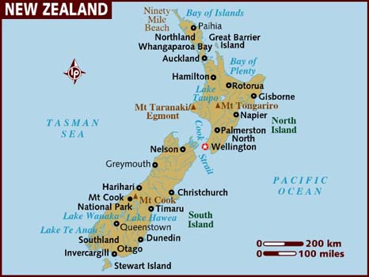
Location

Slide 4
Information
New Zealand's capital city is Wellington, while its most populous city is Auckland.
Official languages: English, Māori, NZ Sign Language
Ethnic groups (2013): 74.0% European, 14.9% Māori, 11.8% Asian, 7.4% Pacific peoples, 1.2% African, 1.7% Other
Goverment: constitutional monarchy with a parliamentary democracy Queen Elizabeth II
Area: 268,021 km²
Population (2018): 4,909,150
Religion:49.0%Christians (Roman Catholicism (12.6%), Anglicanism (11.8%), Presbyterianism (8.5%) The Māori-based Ringatū and Rātana religions (1.4%), Hinduism (2.1%), Buddhism (1.5%), Islam (1.2%) and Sikhism (0.5%).

Slide 5
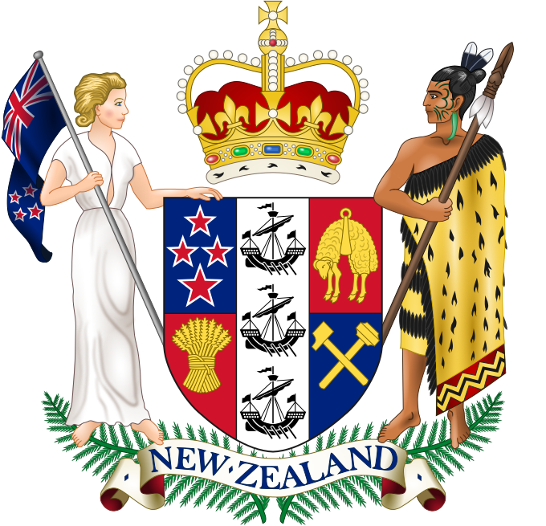
Coat of arms, flag

Slide 6
Geography
Mountain range: Southern Alps
Highest mountain: Aoraki/Mount Cook at 3,754 metres
Taupo Volcanic Zone: the North Island's highest mountain, Mount Ruapehu 2,797 metres
Largest lake: Lake Taupo
Lowland: Canterbury lowland
Rivers: Wairau, Waimakariri and Rangitātā

Slide 7
Geography

Slide 8
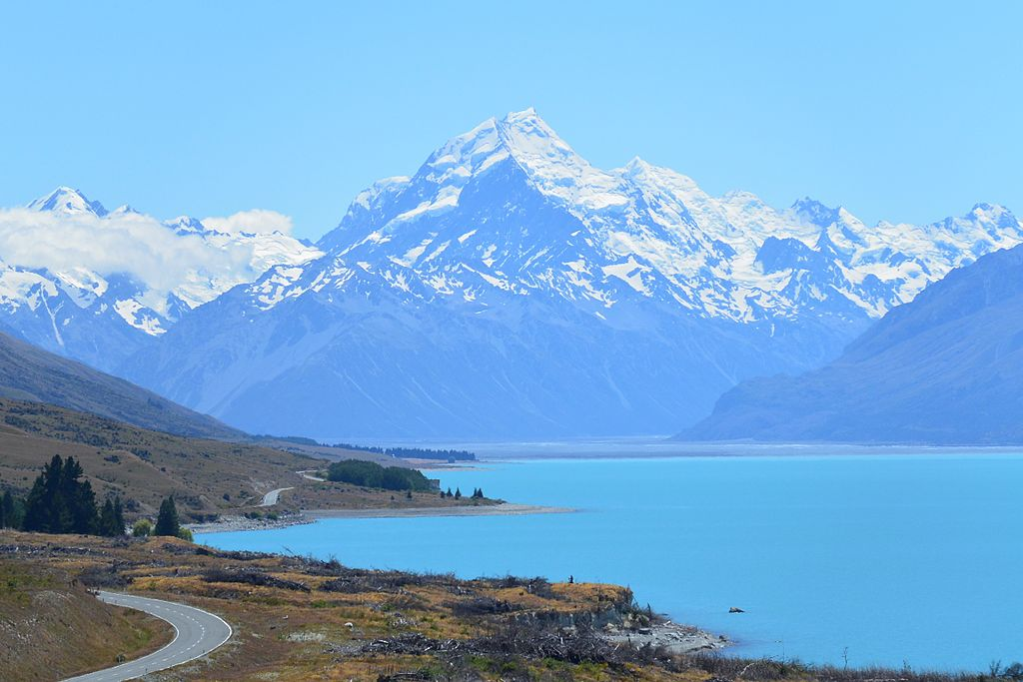
Southern Alps, Mount Cook

Slide 9
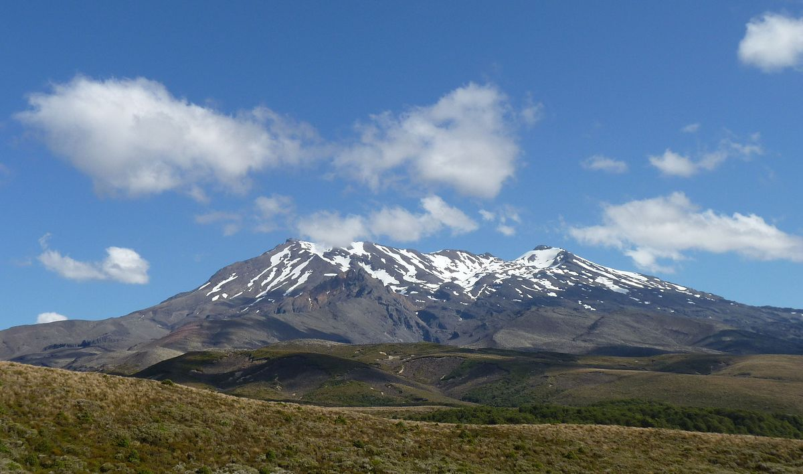
Taupo volcanic zone, Mount Ruapehu

Slide 10
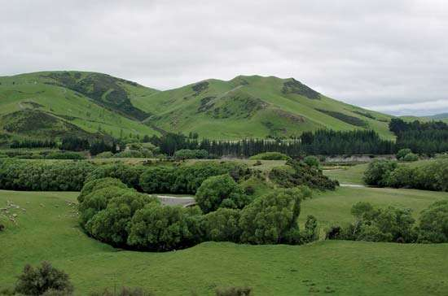
Lake Taupo, Cantenbury lowland

Slide 11
Biodiversity
Birds
Kiwi
Kakapo
Weka
Takahē
Lizards:
Tuatara
Skinks
Geckos

Slide 12
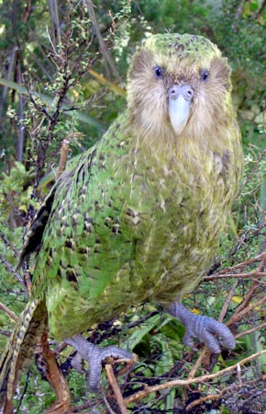
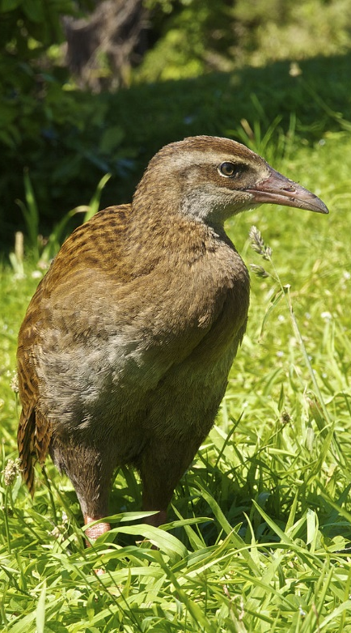
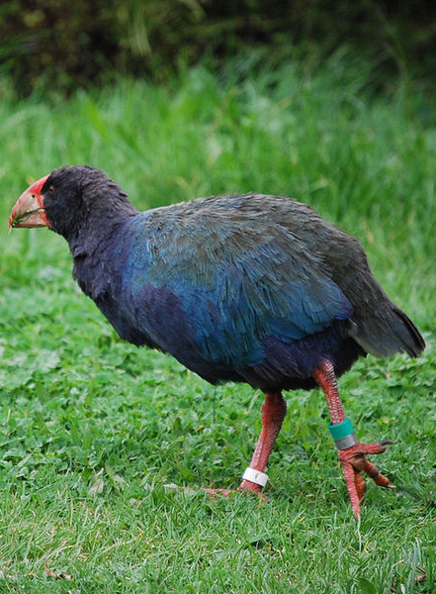
Birds

Slide 13
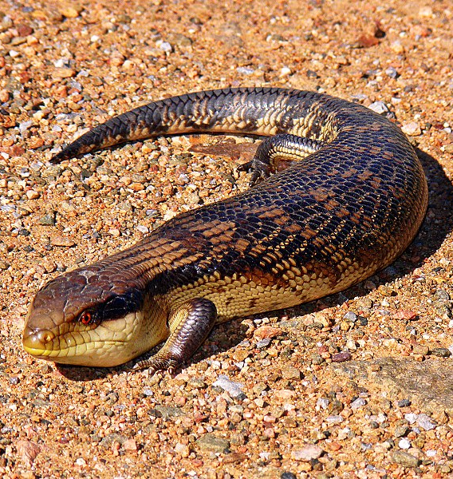
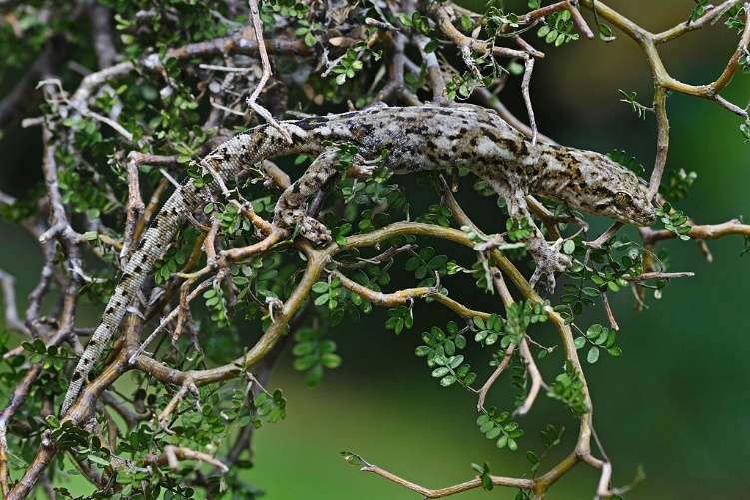
Lizards

Slide 14
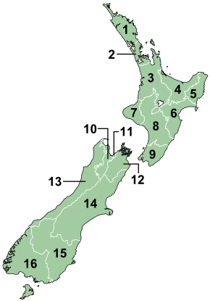
Districts
1. Northland
2. Auckland
3. Waikato
4. Bay of Plenty
5. East Cape
6. Hawke's Bay
7. Taranaki
8. Manawatu-Wanganui
9. Wellington
10. Tasman
11. Nelson
12. Marlborough
13. West Coast
14. Canterbury
15. Otago
16. Southland

Slide 15
History
New Zealand was first settled by Eastern Polynesians between 1250 and 1300
The first Europeans known to have reached New Zealand were Dutch explorer Abel Tasman and his crew in 1642
Europeans did not revisit New Zealand until 1769 when British explorer James Cook mapped almost the entire coastline.
They traded European food, metal tools, weapons and other goods for timber, Māori food, artefacts and water. The introduction of the potato and the musket transformed Māori agriculture and warfare. Potatoes provided a reliable food surplus, which enabled longer and more sustained military campaigns. The resulting intertribal Musket Wars encompassed over 600 battles between 1801 and 1840, killing 30,000–40,000 Māori.

Slide 16
History
From the early 19th century, Christian missionaries began to settle New Zealand, eventually converting most of the Māori population
In 1788 Captain Arthur Phillip assumed the position of Governor of the new British colony of New South Wales which according to his commission included New Zealand.
The Treaty of Waitangi was first signed in the Bay of Islands on 6 February 1840. In response to the New Zealand Company's attempts to establish an independent settlement in Wellington
New Zealand, still part of the colony of New South Wales, became a separate Colony of New Zealand on 1 July 1841

Slide 17
History
As immigrant numbers increased, conflicts over land led to the New Zealand Wars of the 1860s and 1870s, resulting in the loss and confiscation of much Māori land
In 1907, at the request of the New Zealand Parliament, King Edward VII proclaimed New Zealand a Dominion within the British Empire, reflecting its self-governing status.
Early in the 20th century, New Zealand was involved in world affairs, fighting in the First and Second World Wars

Slide 18
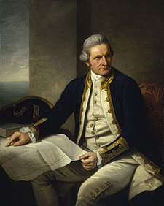
History

Slide 19
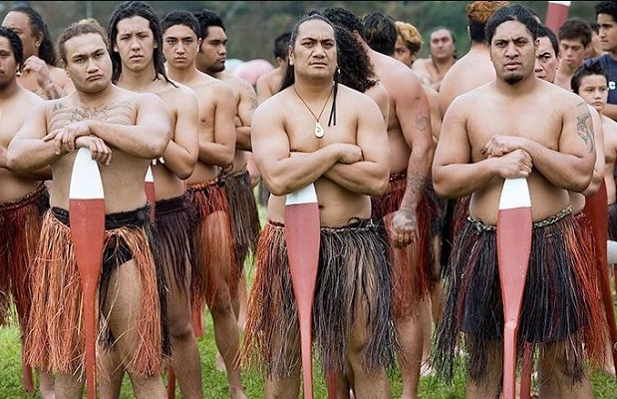
HISTORY

Slide 20
Interesting facts
Hill with longest name: Taumatawhakatangihangakoauauotamateaturipukakapikimaungahoronukupokaiwhenuakitanatahu
There was a shooting of films The Lord of the Rings and The Hobbit
New Zealand was the last major landmass to be populated (with the exception of the polar regions)
New Zealand is one of only three countries that have two official (and of equal standing) national Anthems. The first is God Save the Queen (the English National Anthem) and the other is God Defend New Zealand. The other two countries with two anthems are Denmark and Canada which both have a Royal Anthem and a State anthem. (https://www.youtube.com/watch?v=RYdfQvZrakM)

Slide 21
VOCABULARY
Mountain range
Lowland
Warfare
Treaty

Slide 22
Sources
https://www.lonelyplanet.com/maps/pacific/new-zealand/
https://en.wikipedia.org/wiki/New_Zealand#/media/File:Flag_of_New_Zealand.svg
https://en.wikipedia.org/wiki/New_Zealand#/media/File:Coat_of_arms_of_New_Zealand.svg
https://en.wikipedia.org/wiki/New_Zealand#/media/File:New_Zealand_moutain_ranges.jpg
https://en.wikipedia.org/wiki/New_Zealand#/media/File:Mt_Cook,_NZ.jpg
https://www.researchgate.net/figure/North-Island-New-Zealand-Taupo-Volcanic-Zone-Wairakei-Tauhara-Geothermal-Fieldand_fig1_260311381
https://www.google.com/imgres?imgurl=https://upload.wikimedia.org/wikipedia/commons/thumb/0/07/Tongariro_Northern_Circuit%252C_New_Zealand_%25285%2529.JPG/1200px-Tongariro_Northern_Circuit%252C_New_Zealand_%25285%2529.JPG&imgrefurl=https://en.wikipedia.org/wiki/Mount_Ruapehu&h=708&w=1200&tbnid=jyEicZ-hjPq_CM:&q=Mount+Ruapehu&tbnh=160&tbnw=271&usg=AI4_-kQ24mHkGwF38Hs-fkBW_AFyyL9Wvw&vet=12ahUKEwiI88bS6fTdAhVJqYsKHWtLBFMQ_B0wCnoECAoQCQ..i&docid=GKlUbedwUCD6lM&itg=1&client=firefox-bab&sa=X&ved=2ahUKEwiI88bS6fTdAhVJqYsKHWtLBFMQ_B0wCnoECAoQCQ
https://goingnz.com/travelling-in-new-zealand/things-you-can-do-in-lake-taupo/
https://www.britannica.com/place/Canterbury-Plains

Slide 23
Sources
https://en.wikipedia.org/wiki/Kiwi#/media/File:TeTuatahianui.jpg
https://en.wikipedia.org/wiki/Kakapo#/media/File:Sirocco_full_length_portrait.jpg
https://en.wikipedia.org/wiki/Weka#/media/File:Gallirallus_australis_LC0248.jpg
https://en.wikipedia.org/wiki/File:Porphyrio_hochstetteri_-Tiritiri_Matangi_Island-8b-3c.jpg
https://en.wikipedia.org/wiki/Tuatara#/media/File:Sphenodon_punctatus_in_Waikanae,_New_Zealand.jpg
https://en.wikipedia.org/wiki/Skink#/media/File:Blue-toungued_skink444.jpg
https://en.wikipedia.org/wiki/List_of_geckos_of_New_Zealand#/media/File:Jewelled_gecko_BPmale.jpg
https://en.wikipedia.org/wiki/Districts_of_New_Zealand#/media/File:NZ_Regional_Councils_and_Territorial_Authorities_2017.svg
https://cs.wikipedia.org/wiki/Nov%C3%BD_Z%C3%A9land#/media/File:Regions_of_NZ_Numbered.png
https://en.wikipedia.org/wiki/New_Zealand#History
https://cs.wikipedia.org/wiki/Nov%C3%BD_Z%C3%A9land#D%C4%9Bjiny7

Slide 24
Sources
https://www.google.com/imgres?imgurl=https://upload.wikimedia.org/wikipedia/commons/thumb/7/76/Captainjamescookportrait.jpg/225px-Captainjamescookportrait.jpg&imgrefurl=https://cs.wikipedia.org/wiki/James_Cook&h=282&w=225&tbnid=OVqIhbxREqceKM:&q=james+cook&tbnh=186&tbnw=148&usg=AI4_-kTn2zYRyBleg6AxURQThMfFJ-j3WA&vet=12ahUKEwih-9PX_vTdAhUPglwKHQjYD5QQ_B0wDXoECAsQCQ..i&docid=w47cYjqf1S_xXM&itg=1&client=firefox-b-ab&sa=X&ved=2ahUKEwih-9PX_vTdAhUPglwKHQjYD5QQ_B0wDXoECAsQCQ
https://www.google.com/imgres?imgurl=https://upload.wikimedia.org/wikipedia/commons/thumb/f/f8/AbelTasman.jpg/225px-AbelTasman.jpg&imgrefurl=https://cs.wikipedia.org/wiki/Abel_Tasman&h=185&w=225&tbnid=MGbP6JhcL2pJuM:&q=abel+tasman&tbnh=160&tbnw=194&usg=AI4_-kTupkFkACXa3mMcwl8tnJHz_eVp2w&vet=12ahUKEwiCgNqv_vTdAhXCCMAKHYY-DiwQ_B0wDnoECAYQEw..i&docid=jPSvPggrg1KpsM&itg=1&client=firefox-b-ab&sa=X&ved=2ahUKEwiCgNqv_vTdAhXCCMAKHYY-DiwQ_B0wDnoECAYQEw

Slide 25
Sources
http://www.currentriggers.com/blog/hindu-leader-stands-maori-new-zealand/
https://en.wikipedia.org/wiki/Treaty_of_Waitangi
https://www.newzealand.com/in/article/auckland-and-new-zealand-interesting-facts/
http://listverse.com/2008/06/19/top-20-cool-facts-about-new-zealand/

