Slide 1
SPORT AND PHYSICAL FITNESS

Slide 2
What does a sport hav e to have
an element of competition
be in no way harmful to any living creature
not rely on equipment provided by a single supplier (excluding proprietary games such as arena football)
not rely on any "luck" element specifically designed into the sport.

Slide 3
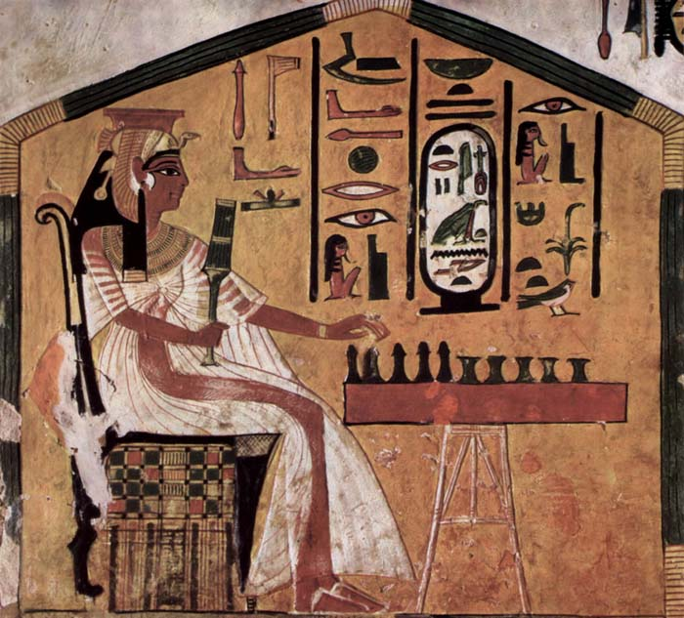
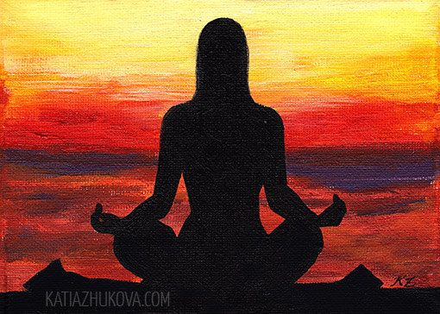
Sports and fitness of times past

Slide 4
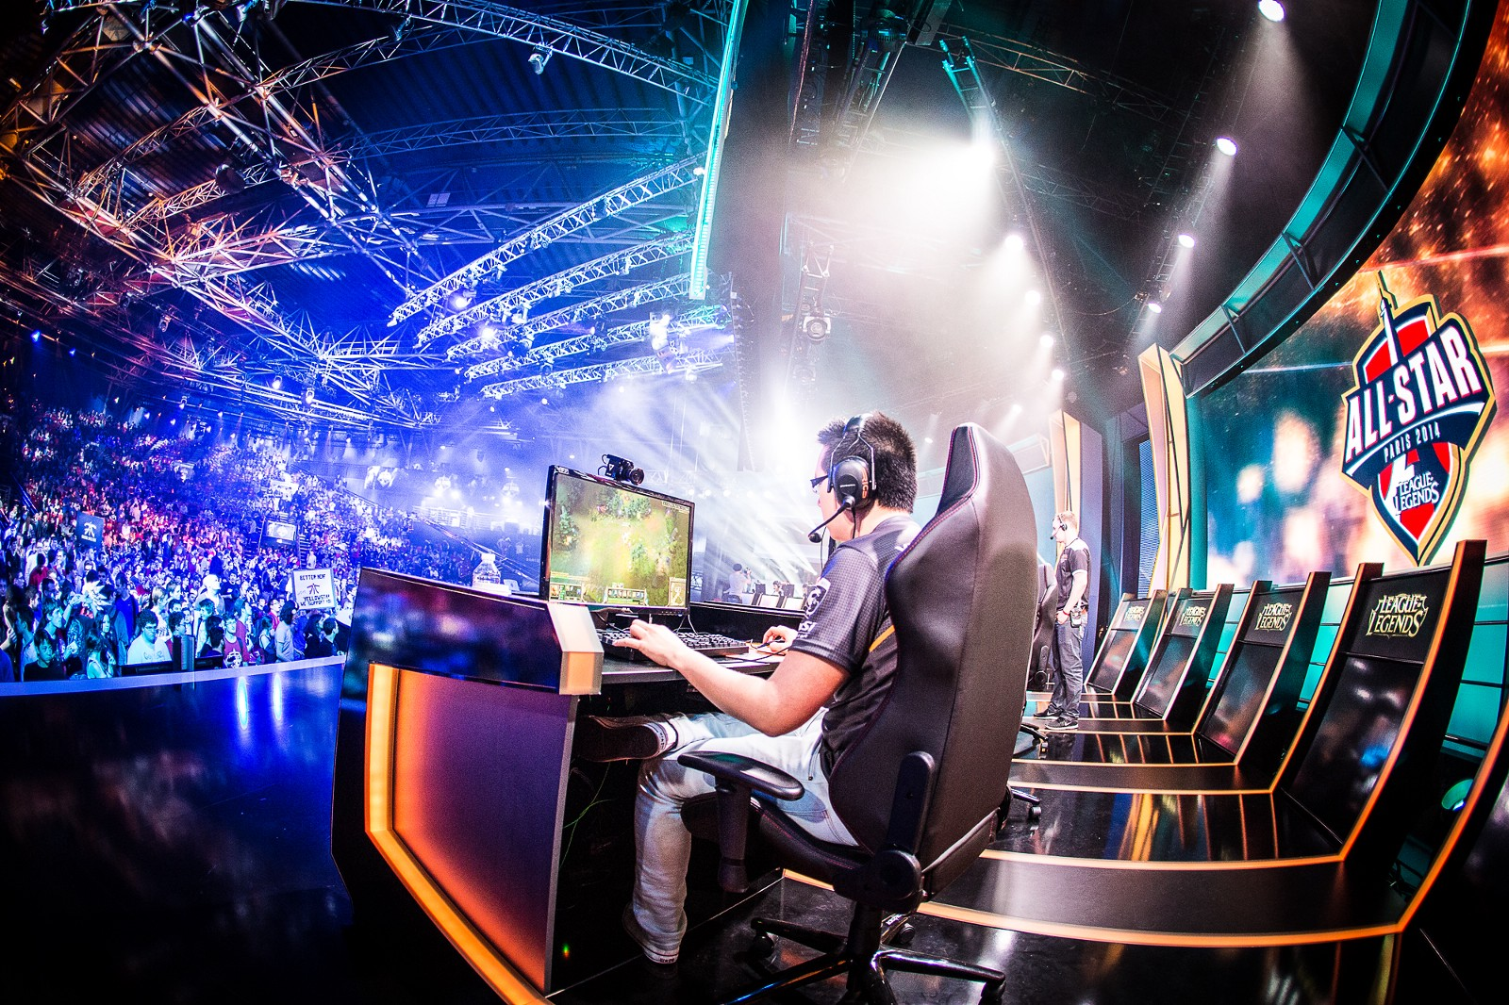
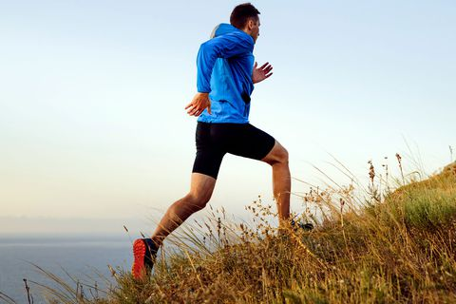
Modern sport and fitness

Slide 6
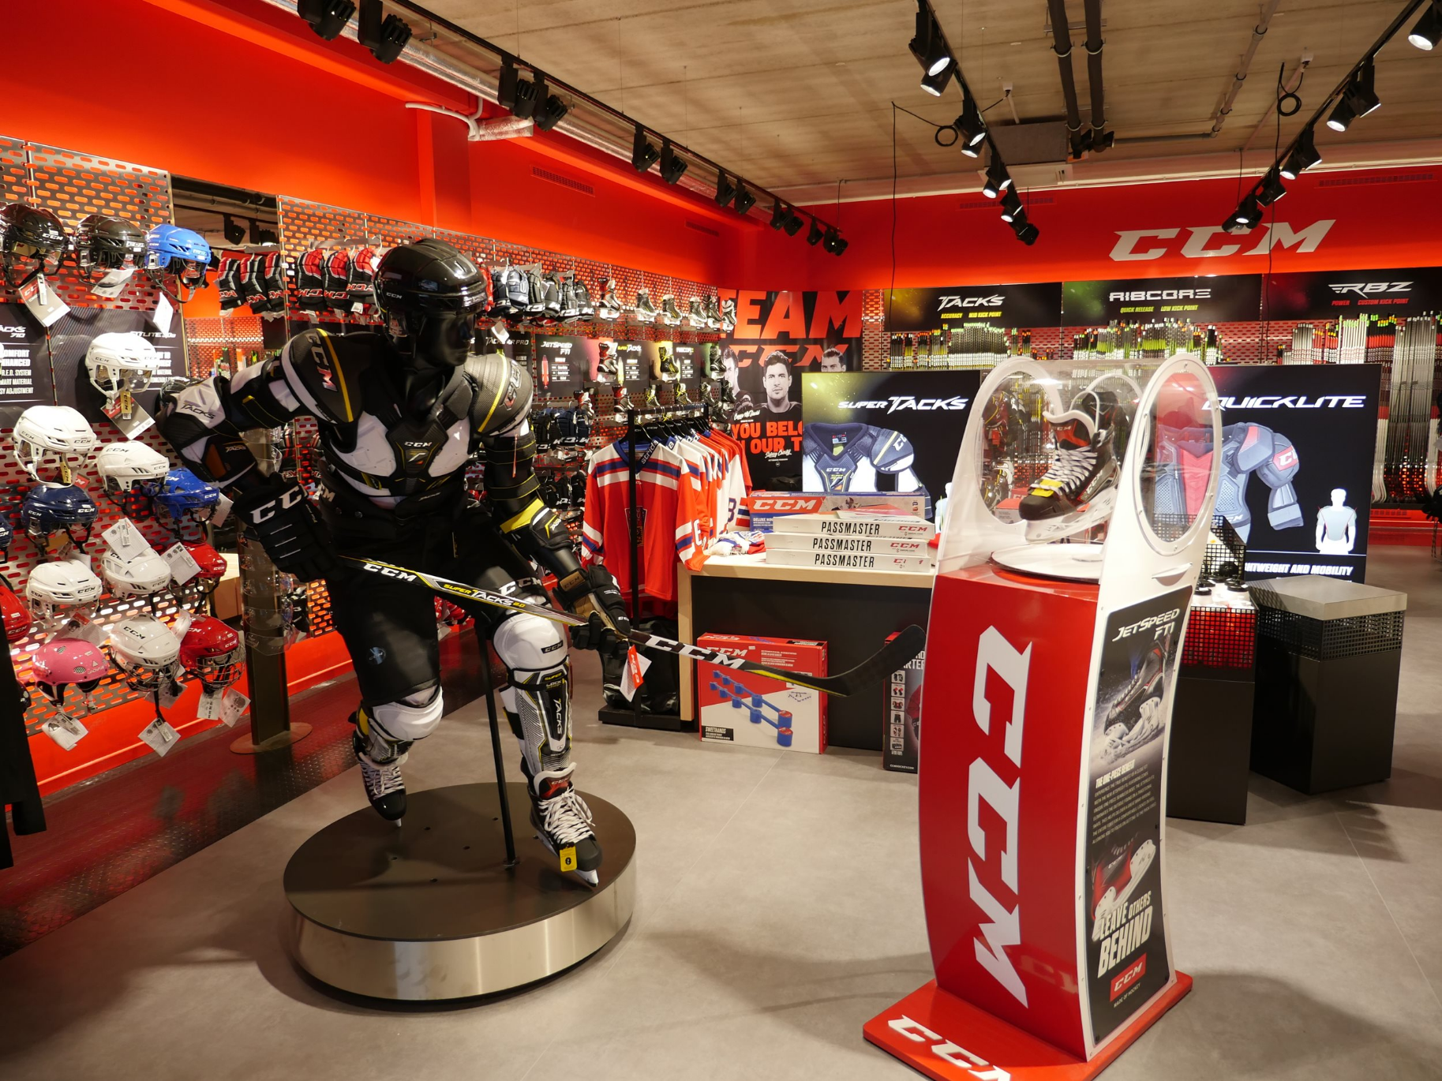
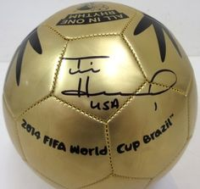
Sports influence

