Slide 1
My town and region
Mimrová Klára

Slide 2
Basic information about Varnsdorf
Country: Czech Republic
Region: Ústí nad Labem
District: Děčín
Area: 26.21 km²
Population: 15 429
Varnsdorf

Slide 3
History of Varnsdorf
The original village has been founded in 1357
Year 1570 Varnsdorf became an independent dominion
In 1849 there was a merging of six villages and Varnsdorf as we know it today has been created
It was the largest village in the Austro-Hungarian Empire
28th July 1868 Varnsdorf officially became a town

Slide 4
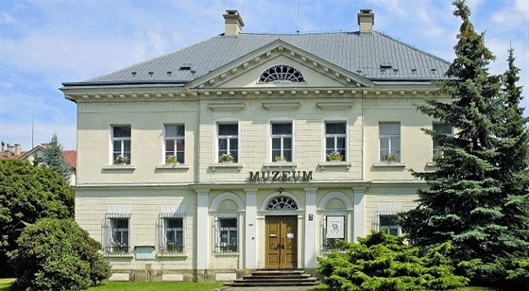
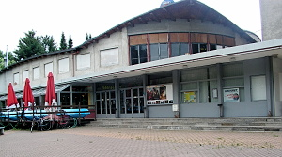
Culture

Slide 5
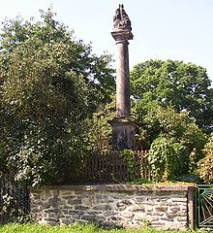
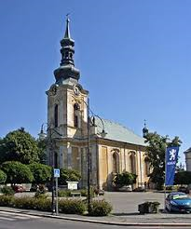
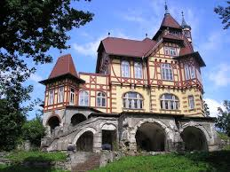
Historical sights
In the city there are 5 churches
Hrádek
Plague Column Nejsvětější Trojice in the street Pohraniční stráže

Slide 6
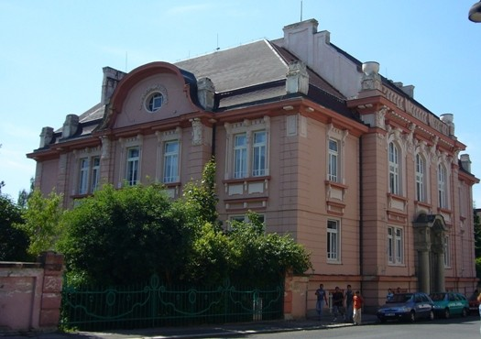
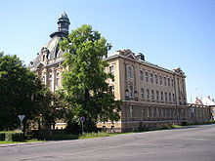
Schools and education
8 kindergartens
Special school
Two secondary schools

Slide 7
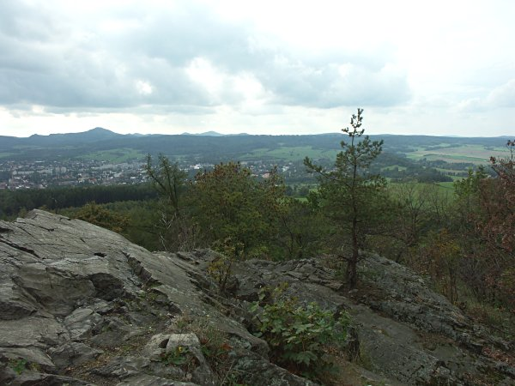
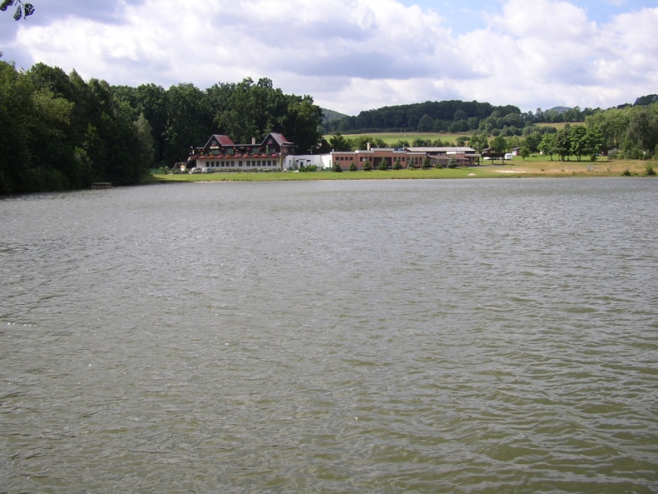
Natural environment
River Mandava
Špičák
Parks
Ponds

Slide 8
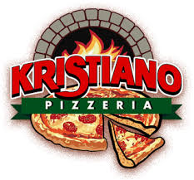
Free time
Cafes
Restaurants
Sport areas

Slide 9
Answer the questions
How many people live in Varnsdorf?
In which year Varnsdorf arose?
In which year Varnsdorf became the town?
Name some historical sights in Varnsdorf
Which river flows through Varnsdorf?
Name one pond in Varnsdorf

Slide 10
Vocabulary
arose – vznikl
dominion – panství
colloquially – hovorově

Slide 11
Sources
https://cs.wikipedia.org/wiki/Varnsdorf
https://www.varnsdorf.cz/cz/o-varnsdorfu/historie/historie-datech.html
https://cs.wikipedia.org/wiki/Varnsdorfský_rybník
Google images

