Slide 1
Education (CR, UK, USA)
Nikola Hendrichová

Slide 2
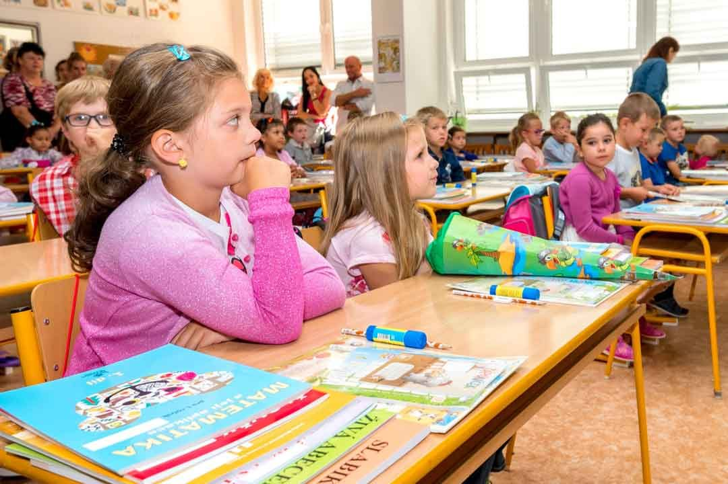
What do you know about the Czech education system?
Levels
Age
Lenght
Types of schools
Educational content (subjects)
Exams
….

Slide 3
Vocabulary
Nursery, kindergarten, playgroup
Grade, year
Pupils
Report card
Apprentice school
Entrance exams
Crafts
Vocational
National curriculum
Arts
Tuition fees
Aptitude test

Slide 4
The Czech Education System
Levels
Pre-school
Primary
Secondary
Terciary

Slide 5
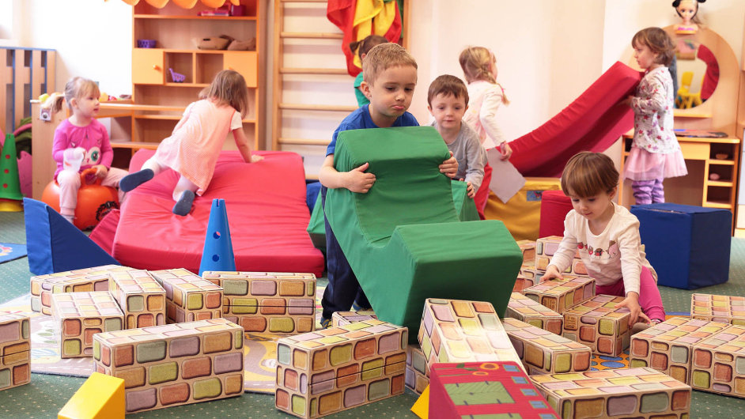
Pre-school education
Nursery school, kindergarten
3 – 6 yo, obligatory from 5
Learning through games, songs and chants, everyday routines, …
Preparation for primary education

Slide 6
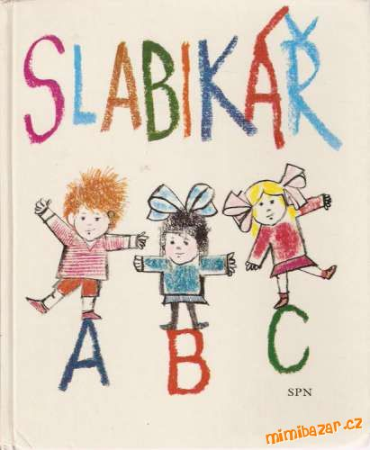
Primary education
Grades 1 – 5
Age 6 – 11
Learning to count, write, read, getting
to know the world, forming behaviour,
morals and routines
One class teacher for most subjects
Obligatory

Slide 7
Secondary education
Lower secondary
Grades 6 – 9
Age 11 – 15
Basic subjects – Czech, maths, foreing language/s (English, German); specialized subjects – history, science (biology, chemistry, physics), …
Different teachers for different subjects
Obligatory
Mostly the same for everyone, with slight differences (grammar schools, schools with some specialization – sport, languages, …)

Slide 8
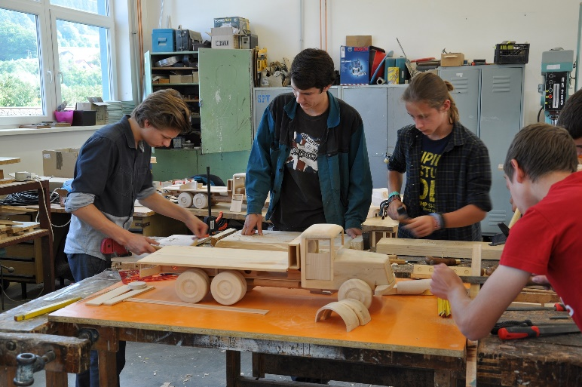
2. Higher secondary (US high school)
Grade 1 – 4
Age 15 – 19
Various types of schools
3-year apprentice schools (specialized, vocational, e. g. crafts; apprentice exam)
4-year specialized schools (academic or vocational - business, health care, IT, …, preparation for a career in a specific area; maturita exam)
Grammar schools (4-year or 8-year, academic education, preparation for university; maturita exam)

Slide 9
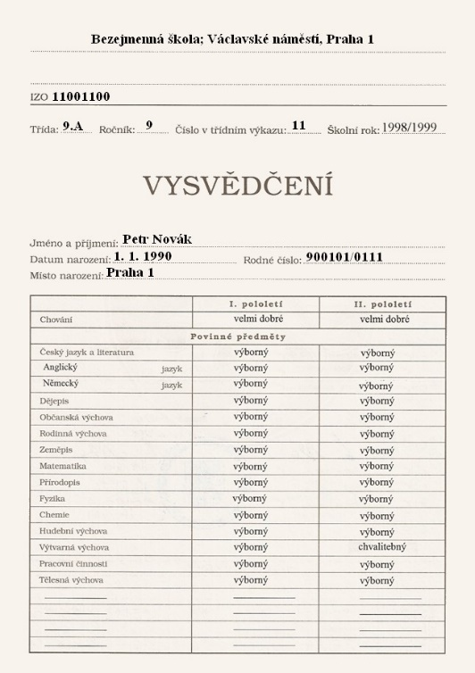
Other facts
The primary and lower secondary levels are obligatory by law
School starts at 8 am
Pupils have approximately 6 lessons per day
One lesson lasts 45 minutes
There are 10-minute breaks, some are longer
Pupils don´t wear uniforms
Pupils get marks (1 – 5)
Schools can be state or private
Schools follow a prescribed national curriculum

Slide 10
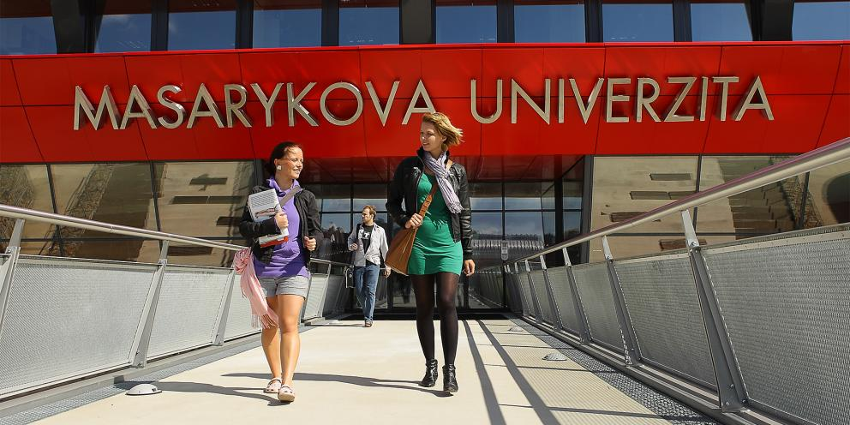
Terciary education
Universities
Age 19 – 26 (supported by the state)
Bachelor degree programmes – 3 years (BA – Bc.)
Master degree programmes – 2 years (MA – Mgr., Ing.)
4 – 6 years – primary teachers, doctors, lawyers
Various fields of study (arts, pedagogy, science, ingeneering, …)
Charles University in Prague, Masaryk University in Brno, Technical University of Liberec, …

Slide 11
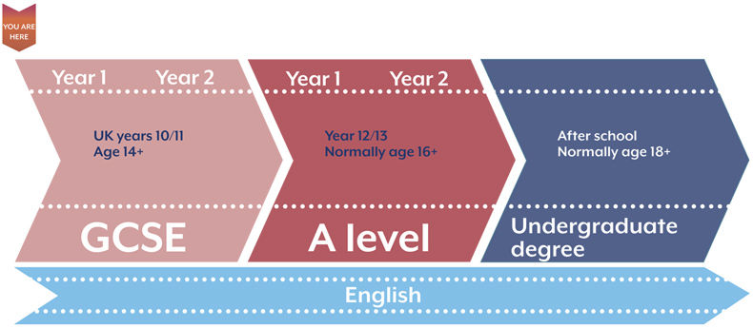
The British Education system
Age of 3 – nursery schools, playgroups
Age of 5 – primary school (zero year)
Age of 6 – primary school (1st year)
Age of 11 – secondary school
Age of 16 – GCSE (General Certificate of Secondary Education) – exam in 8 or 9 subjects
Age of 16 – can leave school or continue studying – a sixth form college (4 subjects, A-level exams) – academic or practical education
Age of 18 – universities (BA, MA; tuition fee)

Slide 12
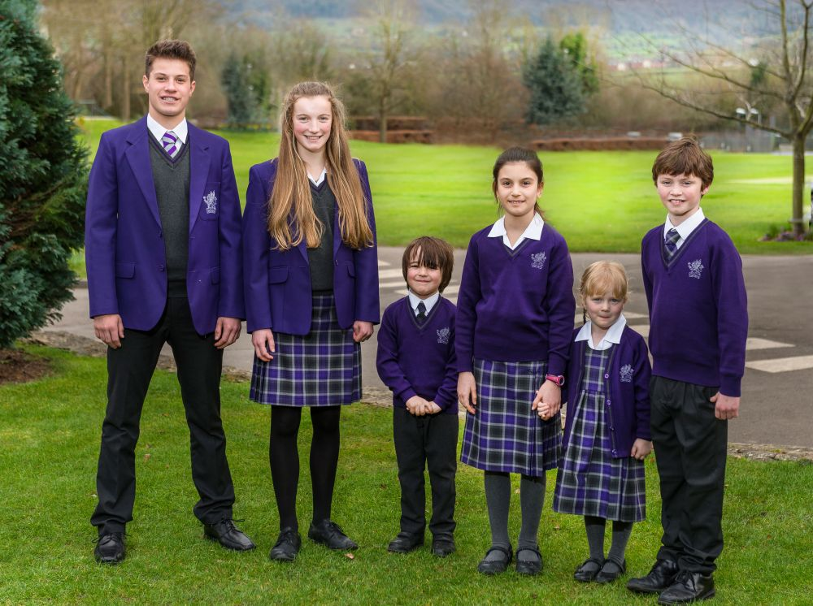
Basic facts
Pupils wear uniforms
Pupils get letters for marks (A – E, U fail)
School starts at nine
Schools are public or private
Schools follow a prescribed national curriculum
Boarding schools

Slide 13
The American Education System
Age 3 or 4 – paid pre-school
Age of 5 - 6 – kindergarten
Age of 6 – elementary/grade school – 5 grades; curriculum determined by a district, basic subjects – English, Maths, science
Age of 11 – Junior High/middle school
Age of 15 – High School (4 grades with special names) – academic and vocational
3rd grade of high school – SAT (Scholastic Aptitute Test) – measures possible success with passing entrance exams to university
Completion of high school – celebrated with a graduation ceremony
Universities and colleges – Yale, Harvard (Ivy League schools)

Slide 14
Basic facts
Morning routine of Pledge of Allegiance
Public (mostly) or private schools
Grading system – A – D, F for fail
Testing in quizzes, essays, other projects

Slide 15
What are the differences between Czech, British and American schooling?

Slide 16
Sources
http://www.bridge-online.cz/wp-content/uploads/2016/09/27_education_uk_usa_cr.pdf
Images.google.com

